Slide 1
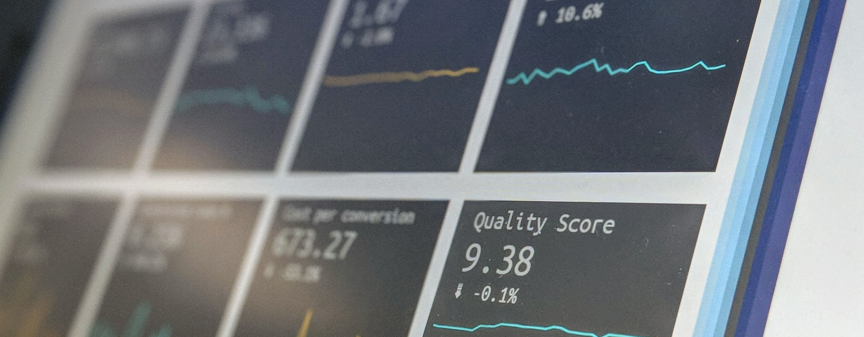
Telecom Customer Churn Analysis
This presentation explores the factors that contribute to customer churn in the telecom industry, with the aim of understanding and addressing this critical business challenge.

Slide 2



Overview
Telecom Customer Churn
Data Overview
Key Metrics
Understand the problem of customer churn, where customers discontinue their service with a telecom provider
Describe the dataset used in the analysis, including the type of data (customer records, call logs, etc.) and the time period covered
Highlight the important metrics used to measure and analyze customer churn, such as churn rate, customer lifetime value, and customer satisfaction
This slide provides an introduction to the problem of telecom customer churn and the data used in the analysis, setting the stage for the deeper insights and findings to be presented.

Slide 3
Bonus :
Advanced Feature Engineering : PCA
Exploring Different Clustering Algorithms: DBSCAN and Hierarchical Clustering
Advanced Visualization : Plotly
Novel Insights

Slide 4
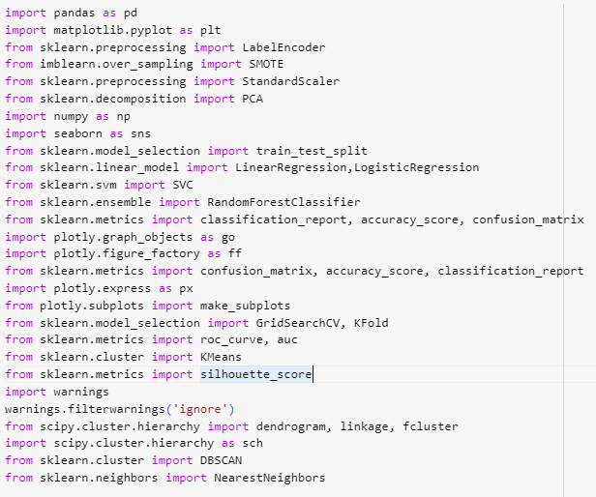
Libraries

Slide 5
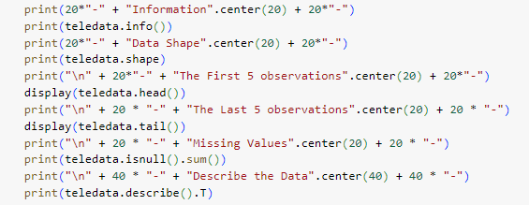
Data Exploration
The data set we are exploring contains information about customer transactions at an online retail store. The data is structured as a table with 8 columns, including customer ID, transaction date, product ID, quantity, and revenue. We have observed that there are several missing values in the quantity and revenue columns, which will need to be addressed during the data cleaning and preprocessing stage.

Slide 6
Data Preprocessing
Data Encoding
Transforming categorical features into numerical representations, such as one-hot encoding or label encoding, to enable the model to understand and process the data effectively.
Handling Imbalanced Data
Addressing imbalances in the dataset, where one class significantly outnumbers the other(s), using techniques like oversampling the minority class, undersampling the majority class, or applying class weighting to ensure the model learns from all classes equally.
Feature Scaling
Normalizing or standardizing the features to a common scale, such as using min-max scaling (normalization) or z-score standardization, to ensure that all features are on a similar range, which is often required for certain machine learning algorithms to work effectively.

Slide 7
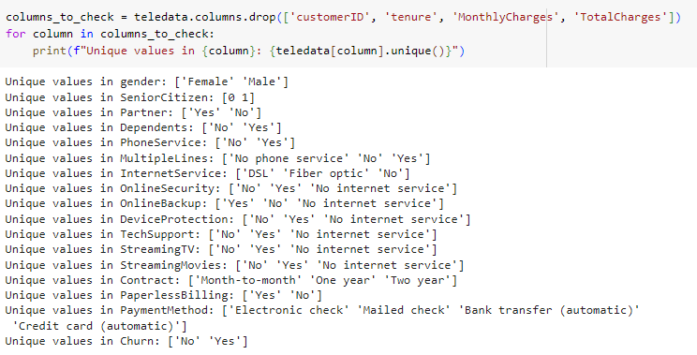
Detection of unique values for preparation to encode

Slide 8
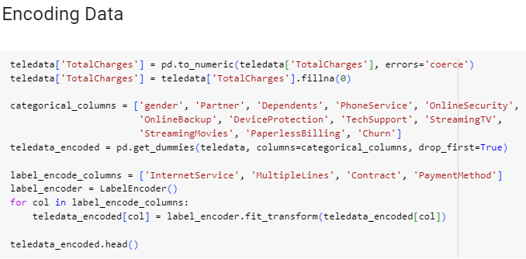
Encoding Data

Slide 9
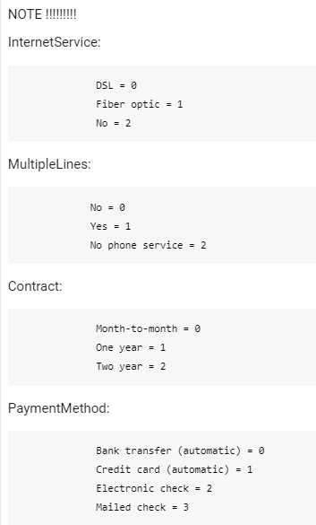

Slide 10
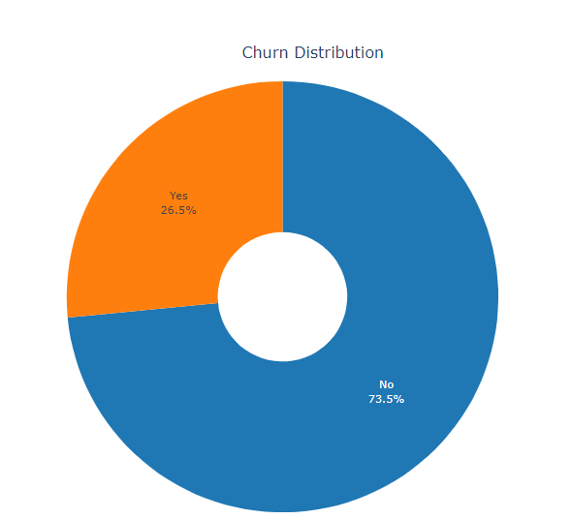
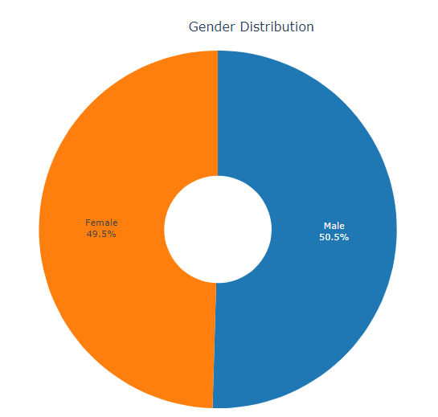
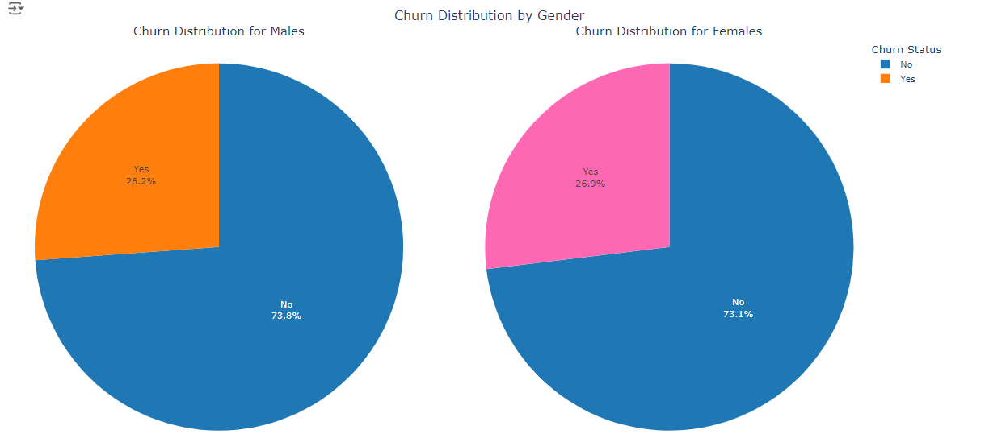
Churn Visualization by Poltly to check the balance of data
Churn distribution
Gender distribution
Churn Distribution by Gender

Slide 11
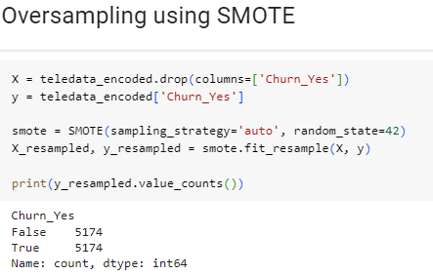
We detect that the data is imbalanced
So We used Over Sampling technique Using
SMOTE

Slide 12
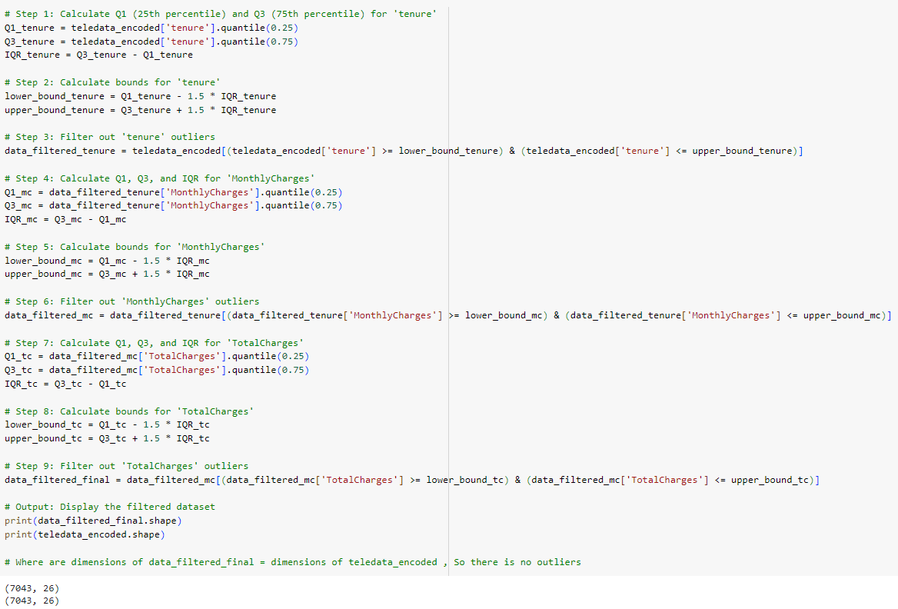
Outlier Detection
Where are dimensions of data_filtered_final = dimensions of teledata_encoded , So there is no outliers

Slide 13
Principal Component Analysis (PCA)
5. Select the Principal Components
7. Evaluate the Dimensionality Reduction
3. Compute the Covariance Matrix
1. Understand the Dataset
Choose the top eigenvectors (principal components) that capture the most variance in the dataset.
Analyze the proportion of variance explained by the selected principal components and the overall performance of the dimensionality reduction.
Calculate the covariance matrix to understand the relationships between the features.
Analyze the structure and characteristics of the dataset to be used for PCA.
4. Find the Eigenvectors and Eigenvalues
2. Standardize the Data
6. Project the Data onto the Principal Components
Normalize the dataset by subtracting the mean and dividing by the standard deviation for each feature.
Perform eigendecomposition to find the eigenvectors and eigenvalues of the covariance matrix.
Transform the original dataset by projecting it onto the selected principal components.

Slide 14
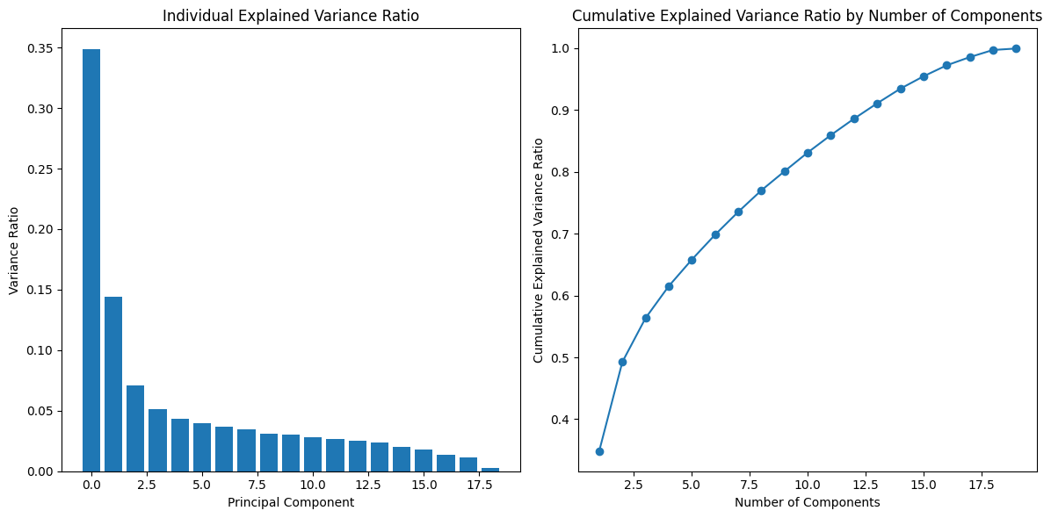
How we chooese n_components ?
From Cumulative Explained Variance Ratio , We know that the best n_components is 19 as the line The line was then fixed

Slide 15
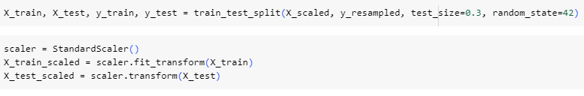
Splitting the data and Standardization

Slide 16
Logistic Regression
What is Logistic Regression?
How does it work?
Assumptions and Limitations
Logistic regression uses a logistic function to model the relationship between the input features and the binary target variable. It calculates the probability of an event occurring and then applies a threshold to classify the outcome.
Logistic regression is a supervised machine learning algorithm used for binary classification problems, where the goal is to predict a binary outcome (e.g., yes/no, 0/1).
Logistic regression assumes that the relationship between the input features and the target variable is linear, and that the errors follow a binomial distribution. It may not perform well in cases where the assumptions are violated or with highly nonlinear data.
Logistic regression is a powerful and versatile machine learning algorithm that is well-suited for binary classification tasks. By understanding its underlying principles and limitations, you can effectively apply it to solve a wide range of real-world problems.

Slide 17


Logistic Regression Model Performance
Metric
Value
Training Accuracy
0.7844815684108795
Test Accuracy
0.8016103059581321

Slide 18
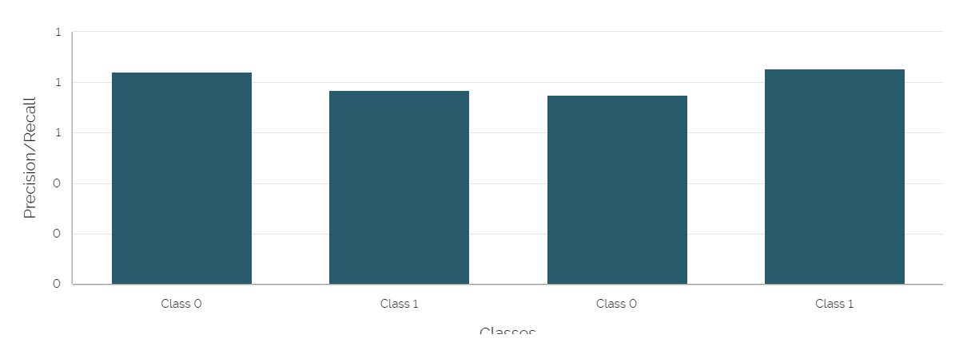
Logistic Regression Model Performance
The Logistic Regression model performs well with an overall accuracy of 80.16% on the test set.

Slide 19
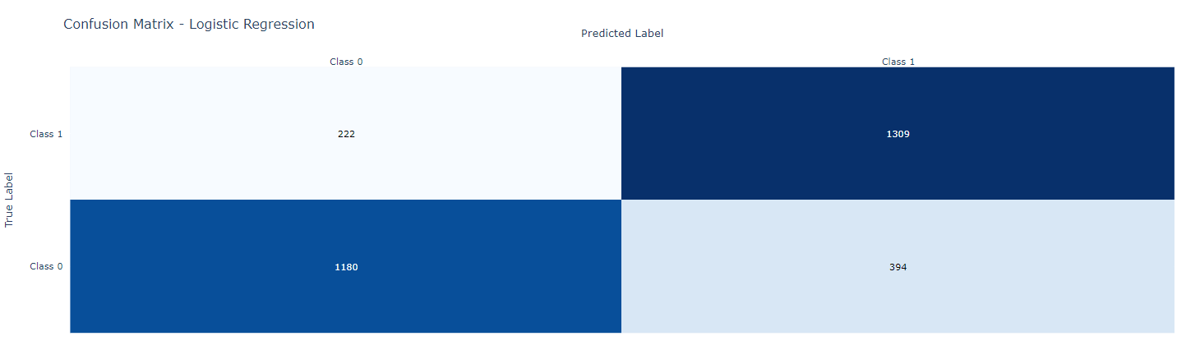
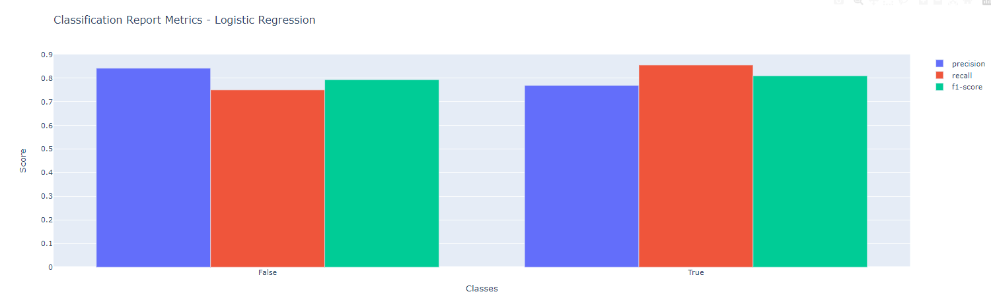
Confusion Matrix & Classification Report Using Plotly
Confusion Matrix
Classification Report

Slide 20




Support Vector Machine (SVM)
Support Vector Machine (SVM)
Supervised Learning Approach
Hyperplane Optimization
Kernel Trick
SVMs find the optimal hyperplane that maximizes the margin between the different classes, resulting in better generalization.
SVMs can handle non-linear decision boundaries by using kernel functions to map data into a higher dimensional space.
A powerful machine learning algorithm used for classification and regression tasks.
SVMs learn from a labeled dataset to create a model that can accurately predict new, unseen data.
SVMs are a versatile and effective machine learning technique that can tackle a wide range of classification and regression problems.

Slide 21
SVM Model Performance
Metric
Value
Training Accuracy
0.8227253900317548
Test Accuracy
0.8202898550724638

Slide 22
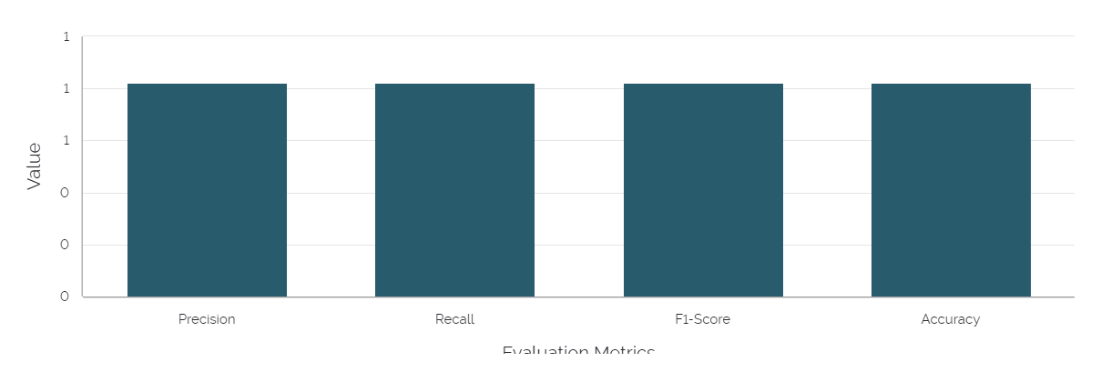
SVM Classification Metrics
The SVM classification model has good precision, recall, F1-score, and accuracy, indicating it performs well in classifying the data.

Slide 23
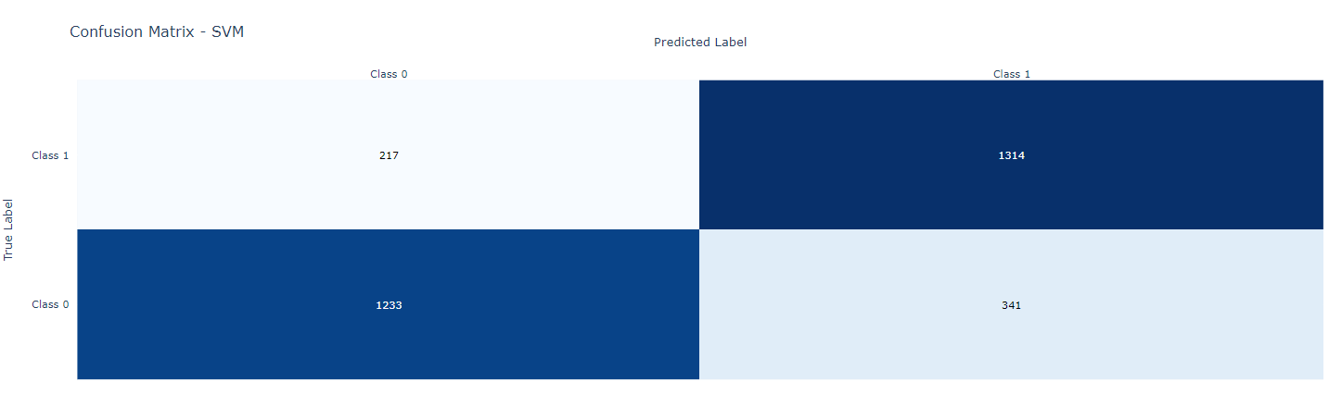
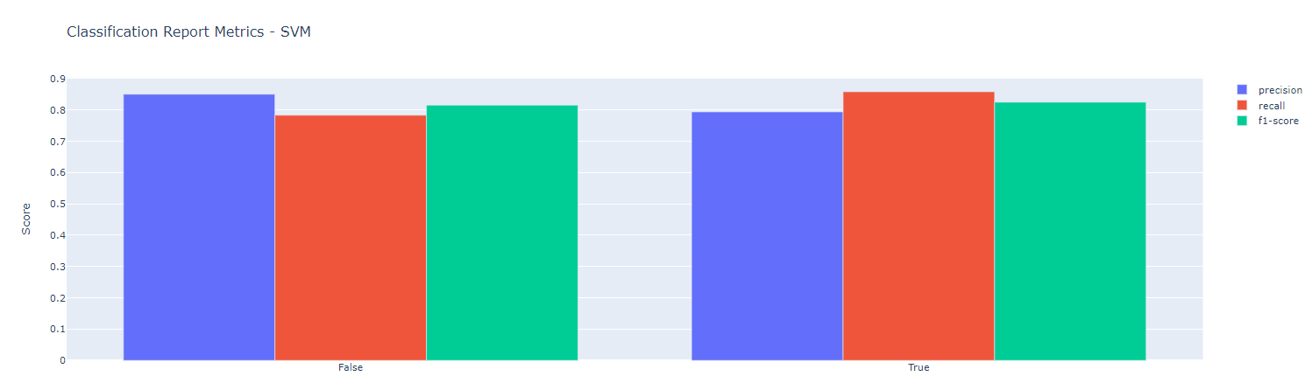
Confusion Matrix & Classification Report Using Plotly
Confusion Matrix
Classification Report

Slide 24

Random Forest Model
What is Random Forest Model?
Features of Random Forest
Applications of Random Forest
Random Forest is an ensemble learning method for classification, regression, and other tasks. It operates by constructing a multitude of decision trees during training and outputting the class that is the mode of the classes or mean prediction of the individual trees.
Random Forest models are highly versatile, can handle both classification and regression tasks, are robust to overfitting, and can automatically handle missing values and outliers.
Random Forest models are widely used in various domains such as credit risk assessment, fraud detection, customer churn prediction, image recognition, and many more.
In summary, Random Forest is a powerful and versatile ensemble learning algorithm that has found widespread applications in various domains. Its ability to handle diverse datasets, robustness to overfitting, and ease of interpretation make it a popular choice among data scientists and machine learning practitioners.

Slide 25

Random Forest Model Performance
Metric
Value
Training Accuracy
0.9990335496341296
Test Accuracy
0.8412238325281803

Slide 26
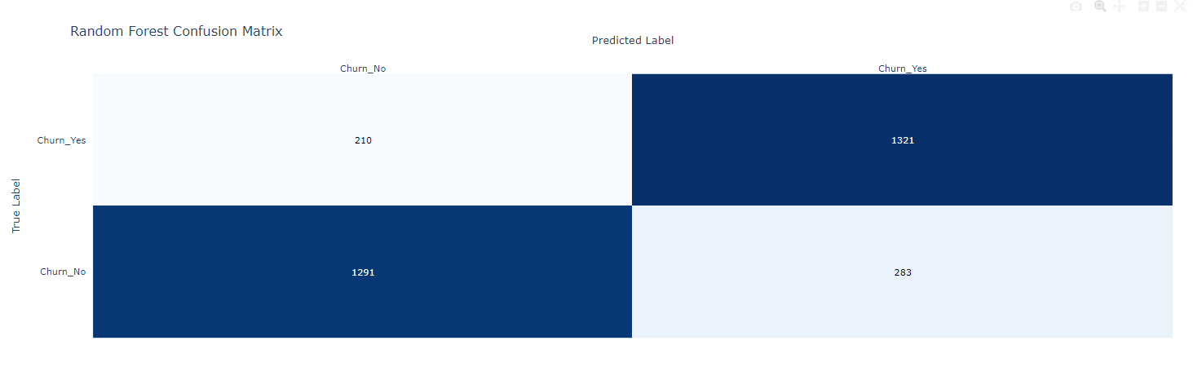
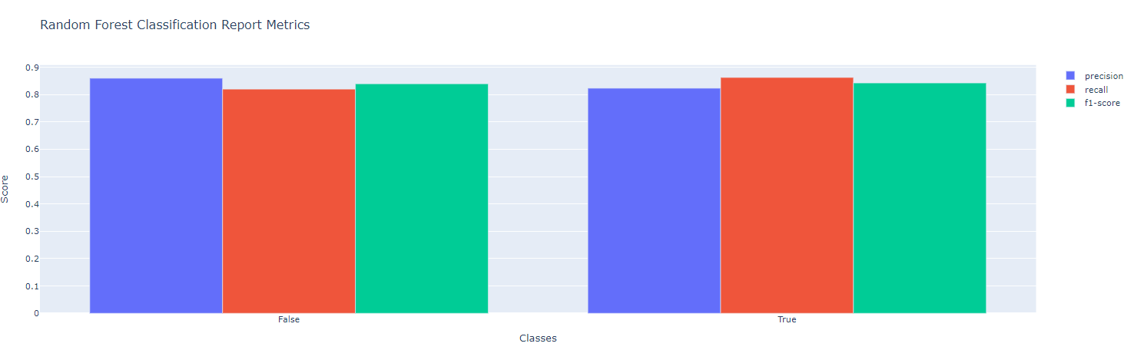
Confusion Matrix & Classification Report Using Plotly
Confusion Matrix
Classification Report

Slide 27








Random Forest Classifier Performance
0.86
0.82
0.84
0.84
Precision
Recall
F1-Score
Accuracy
The Random Forest Classifier has a strong performance with high precision, recall, F1-Score, and overall accuracy.

Slide 28
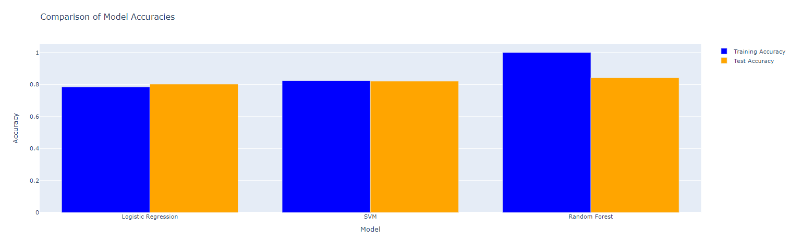
Model Comparison Using Plotly

Slide 29
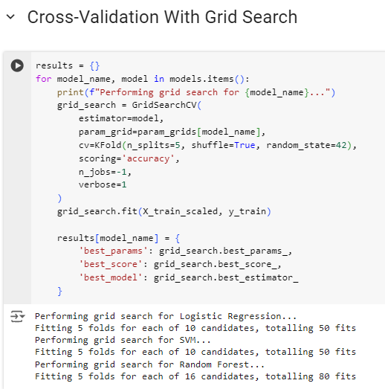
Grid Search With Cross-Validation

Slide 30
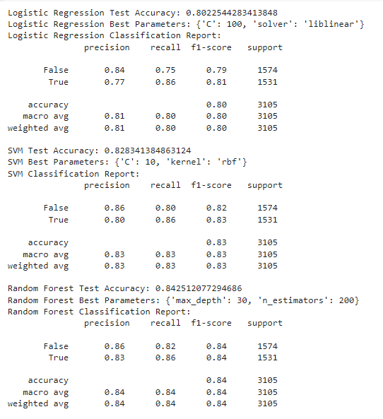
Evaluation of the Best Models

Slide 31



The Best Model
Random Forest Classifier
n_estimators = 50
random_state = 42
A powerful ensemble learning algorithm that combines multiple decision trees to make predictions.
The number of decision trees in the forest. Setting it to 50 can provide a good balance between model complexity and performance.
Ensures reproducibility of the model by setting a fixed random seed, which is important for consistent results and debugging.
The Random Forest Classifier with 50 estimators and a random state of 42 is a well-tuned model that can provide reliable and accurate predictions.

Slide 32
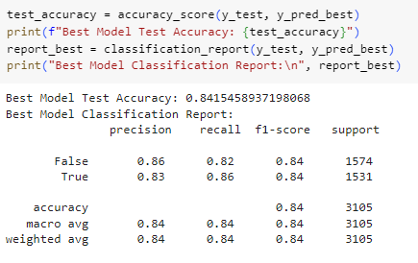
Evaluation of the best model

Slide 33
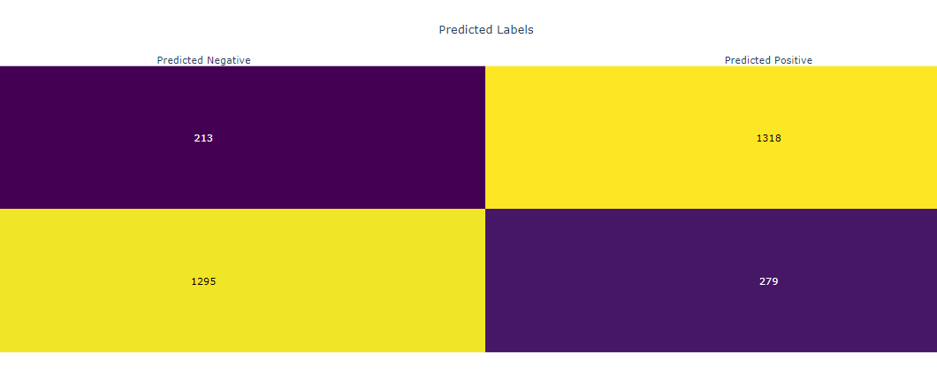
Confusion Matrix of the best model

Slide 34
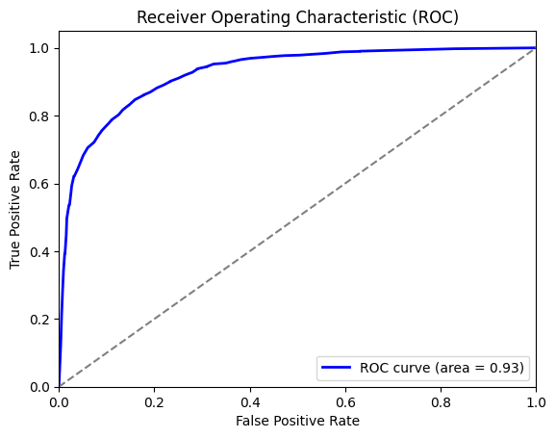
ROC Curve and AUC : 0.93

Slide 35
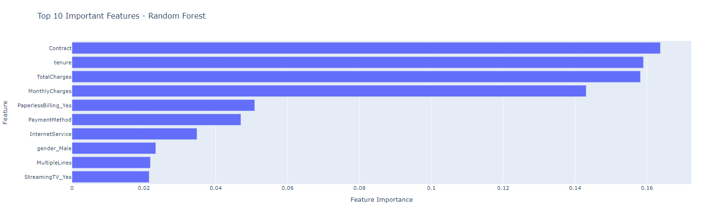
Top 10 Important Features - Random Forest
Feature Importance Ranking
A bar chart displaying the relative importance of different features, such as contract, and tenure in predicting customer churn.

Slide 36



K-Means Clustering
What is K-Means?
How does it work?
When to use K-Means?
K-Means is a popular unsupervised machine learning algorithm used for clustering data into groups based on their similarities.
K-Means partitions the data into k clusters, where each data point belongs to the cluster with the nearest mean. The algorithm iteratively refines the cluster assignments until convergence.
K-Means is effective for clustering large datasets, identifying customer segments, image segmentation, and many other applications where grouping data is necessary.
In summary, K-Means is a powerful clustering algorithm that is widely used in various applications due to its simplicity, efficiency, and effectiveness in grouping similar data points together.

Slide 37
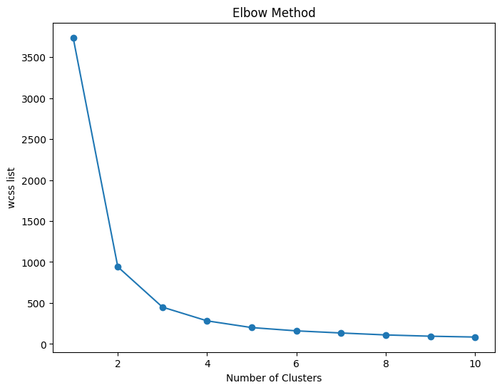
Elbow method
From this plot , We considered that the optimal K is 3

Slide 38
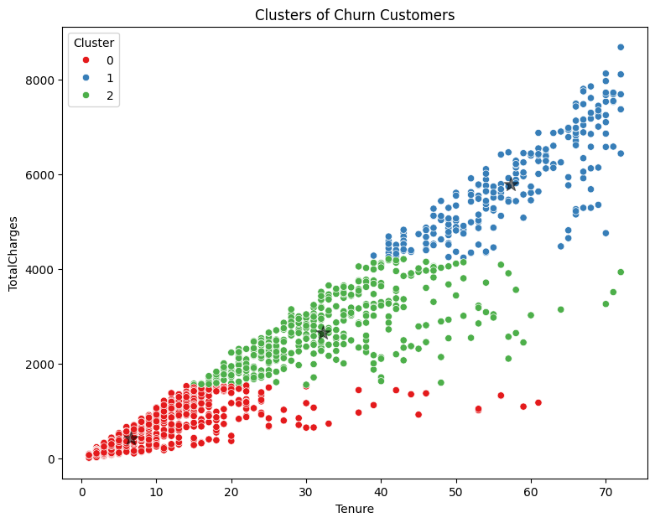
The Visualization of Clustering
x='tenure'
y='TotalCharges'

Slide 39
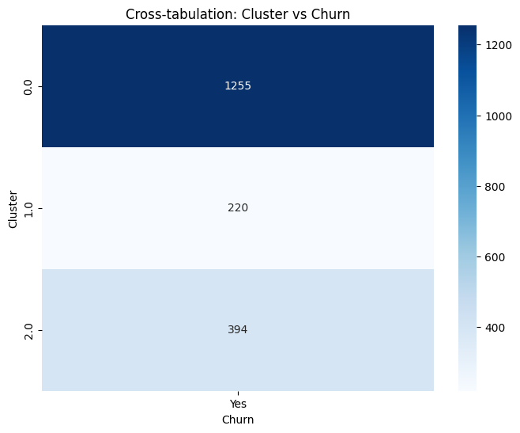
Cross-tabulation: Cluster vs Churn

Slide 40
Silhouette Score for 3 clusters: 0.6364276935211584

Slide 41
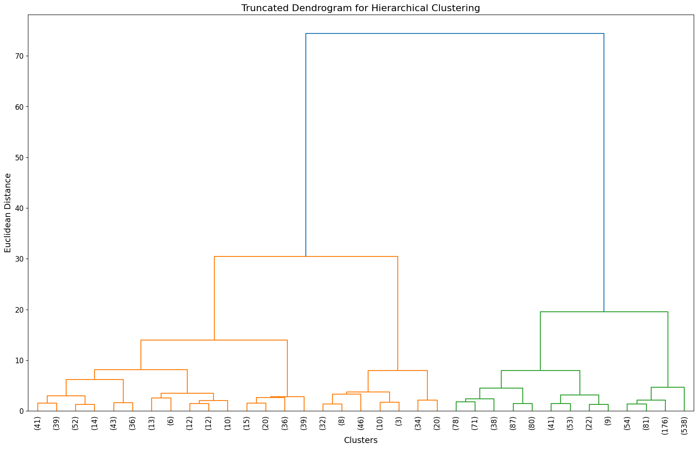
Hierarchical Clustering
Using the combined labels based on tenure and TotalCharges
Truncation the dendrogram
Showing only the last 35 merged clusters

Slide 42
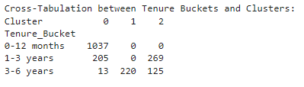
Cross-Tabulation by Tenure Buckets and Clusters
tenure buckets to group customers into meaningful ranges for example ( low, medium, high tenure)

Slide 43
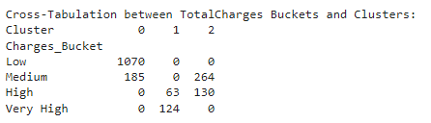
Cross-Tabulation by TotalCharges Buckets and Clusters
TotalCharges buckets to group customers based on how much they have been charged

Slide 44
DBSCAN: Density-Based Spatial Clustering
DBSCAN is a popular unsupervised machine learning algorithm used for clustering data. It is particularly effective at identifying clusters of arbitrary shape and size, and can handle outliers well. DBSCAN stands for Density-Based Spatial Clustering of Applications with Noise, and it works by grouping together data points that are close to each other, based on density.

Slide 45
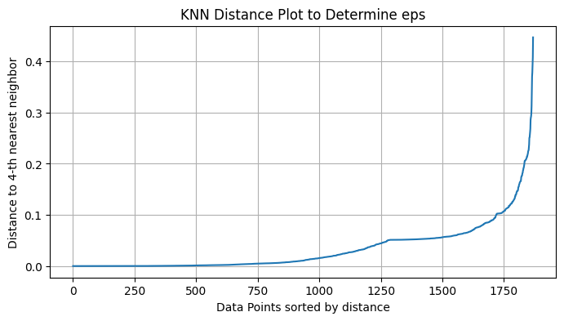
KNN to know the optimal eps and min_samples in DBSCAN
From this plot , We can conclude that the optimal eps=0.18 and the optimal min_samples=4

Slide 46
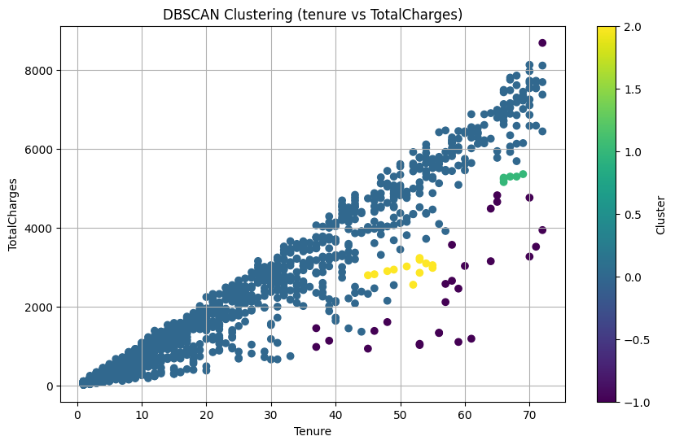
DBSCAN Clustering (tenure vs TotalCharges)

Slide 47



The Team
Yahya Ahmed
Doaa Samir
Salma Mohamed

Slide 48

Greet Thanks To All who Worked for this opportunity, You mean a lot to us
This is about the success of a collaborative effort. The hard work and dedication of the members who contributed to this opportunity have truly made a significant impact. Their contributions have been invaluable, and their support has been essential in making this endeavor a reality.

